Slide 1
Airport Database
Atakan Cocen, Brian Cox, Marc Dickey

Slide 2
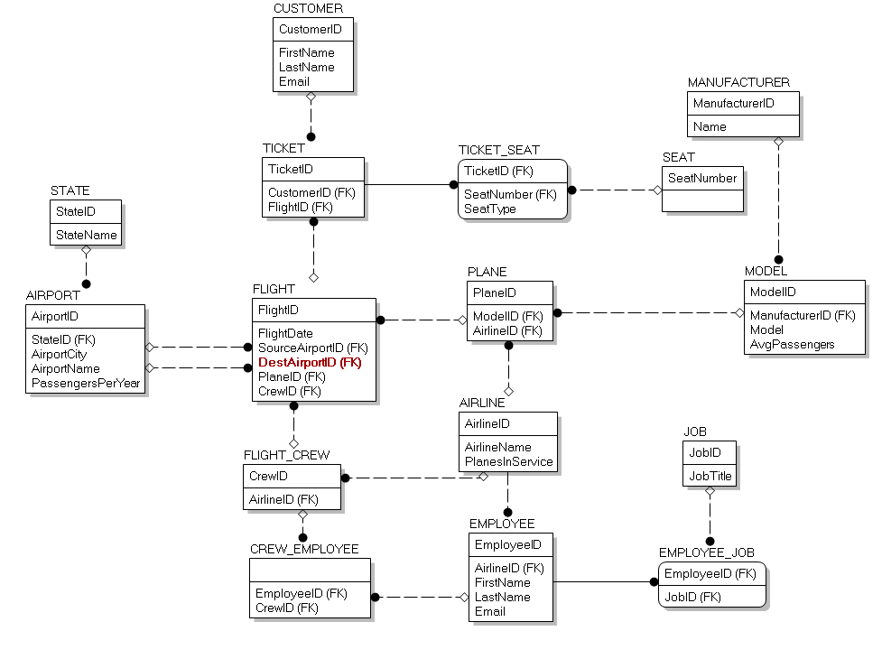
Project Narrative
Simulate a database that would be useful for employees involved in administration of United States airports and domestic flights.
Includes data regarding airports, airlines, flights, planes, employees, etc.

Slide 3
Scope
Target for our database is to sort through and categorize information
User is able to lookup an airport from any of the fifty states
Information such as:
Employees and their information
Type of aircraft/airlines cooperating with the airport
Flights
GUI made with C#
Home Page has six buttons
Manage Airports
Manage Airlines
Manage Flights
Manage Employees
Manage Customers
Search
Map to display fifty states and details

Slide 4
Softwares and Languages
Visual Studio combined with C# (Windows Forms Application)
Microsoft SQL Server Management Studio 2016
Amazon Web Services (AWS)
Erwin Data Modeling

Slide 5
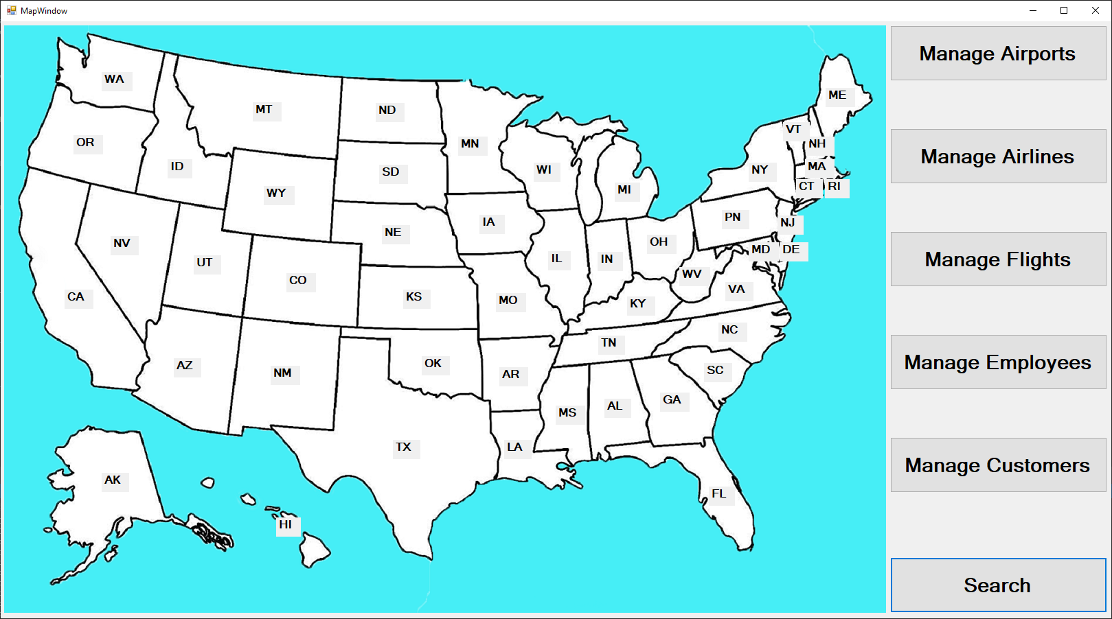
GUI Design

Slide 6
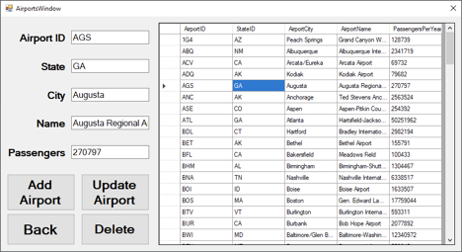
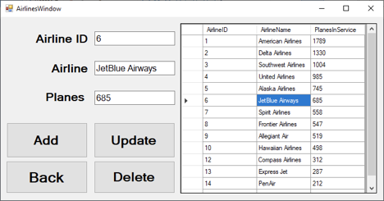
GUI Design

Slide 7
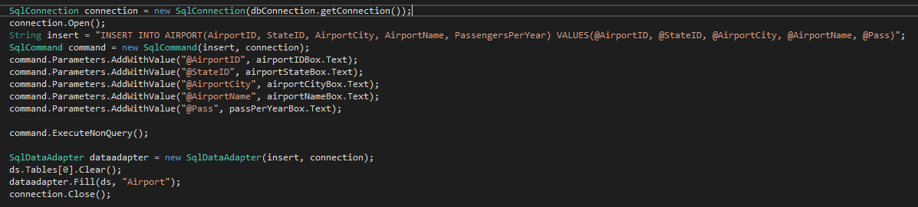
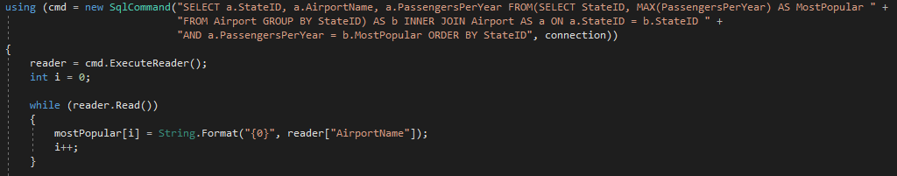
Code Snippets

